Slide 1

Dynamic Mode Decomposition (DMD) in Salient Region Identification
A mast 680 project By: Will Sze
Notes:
Name
Graduate Student in my first year
Project topic

Slide 2
Table of Contents
Overview
What is Saliency in Images?
Applications
Existing Algorithms
Purpose
Review DMD Theory
Algorithm
Results
Summary and Conclusion
Notes:
For the content. Will Start with
The overview of the subject
Purpose
Review DMD together
General steps of the algorithm
Show some of the results obtained
Well summarize and conclude the presentation

Slide 3

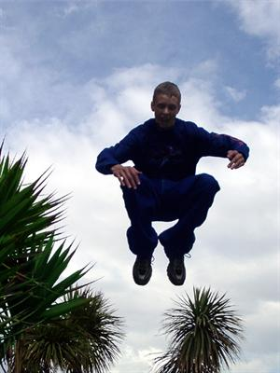
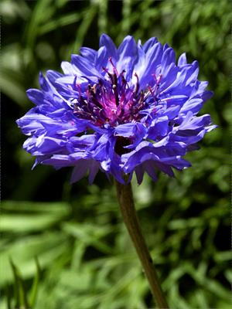
What is Saliency in Images?
Overview
Purpose
Theory
Algorithm
Results
Notes:
So what exactly is saliency
Take a moment to look at each of these pictures
- Take note of which areas you tend to focus on first.
Obvious regions in each picture where we focus
In the first image
The flag
Maybe the warning sign
In the second image
Person jumping catching attention
In the third image
The flower petals.
These regions that catches our attention: salient regions.
In computer vision, it might be important to locate these regions. Since we may want to keep things that matter the most.

Slide 4
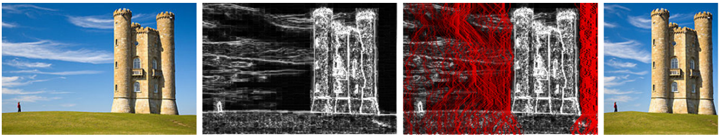
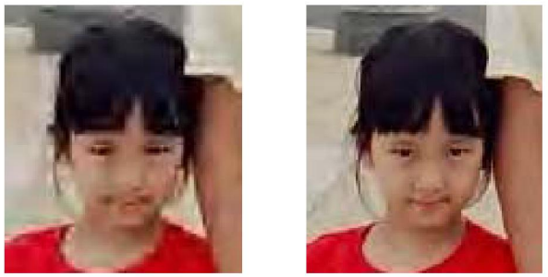
Applications
- Image Retargeting
Change the resolution and scale the image without distortion
Image compression preserving details on important regions
Li and Gao, 2014
Han and Vasconcelos, 2014
Overview
Purpose
Theory
Algorithm
Results
Notes:
Here are some applications
Showing 2 out of the many others.
The first is image retargeting.
If we can identify the important regions, then cut out the non important regions and scale. Retargeting does it in a way that makes it look natural
Another application is in image compression
We can keep details important regions while reducing details in other non important regions.
The 2 images have roughly the same file size.

Slide 5
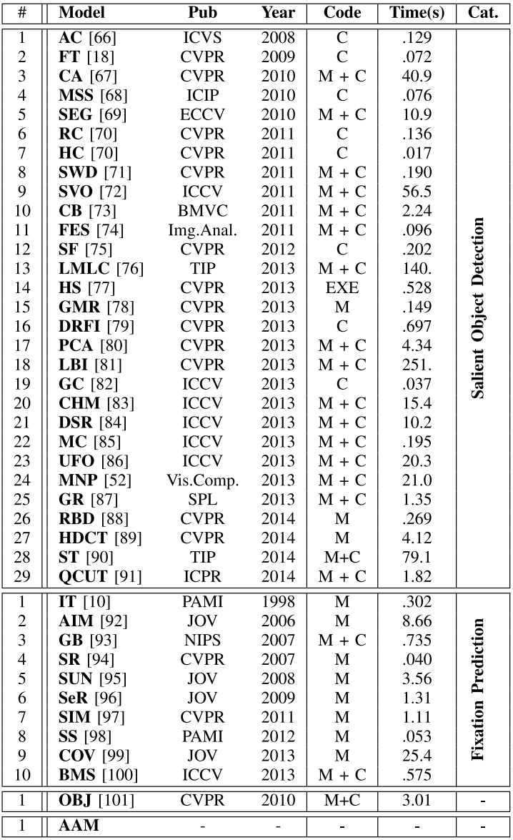
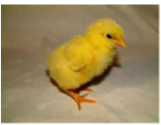
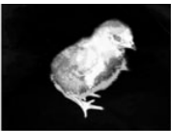
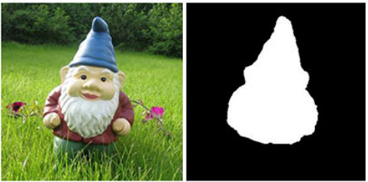
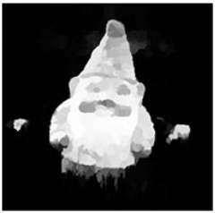
Existing Algorithms
- HC by Cheng et al in 2015: Used contrast to detect salient regions
- SuperCNN by He et al in 2015: Used convolutional neural networks with pre-labled images to train a model to detect salient region
Overview
Purpose
Theory
Algorithm
Results
Notes:
There are many algorithms that already exist trying to detect salient regions.
HC (Histogram based contrast method) which uses contrast to detect regions of interest
Another one here SuperCNN uses convolutional neural networks to identify the regions using pre-labeled images
There are many other algorithms out there and we are mainly concerned about the precision and computation time.
We can usually classify these algorithms in two categories: Bottom-up and Top-down
- IT by Itti et al in 1998: Used color and luminance with neural network to determine different regions of saliency

Slide 6
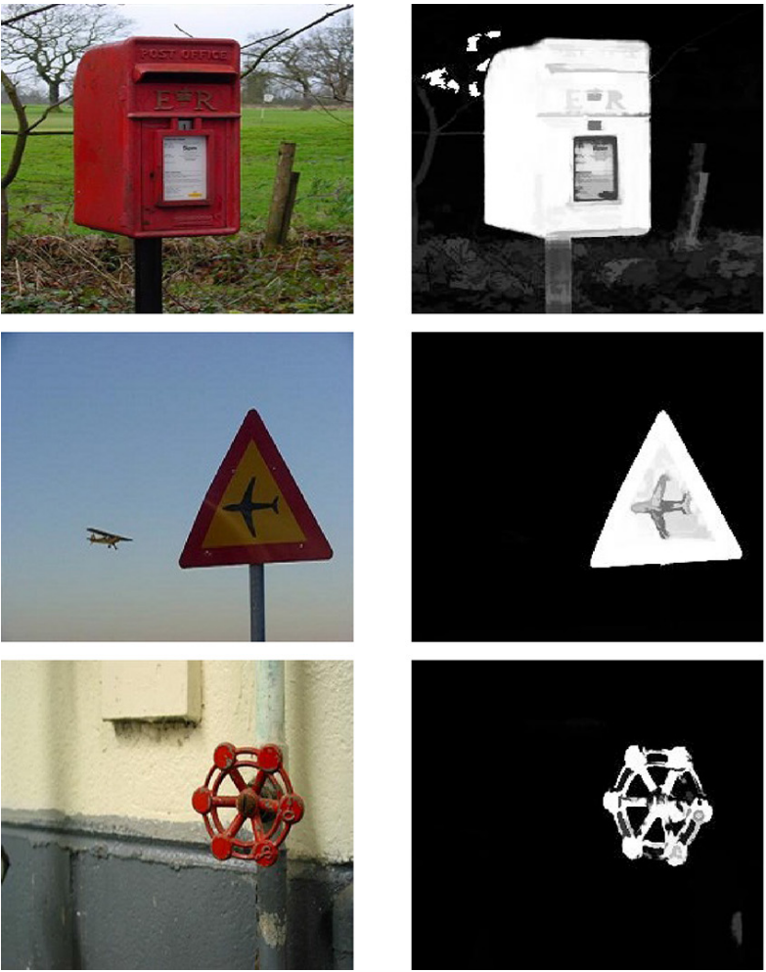
Purpose of the Project
- To explore the use of DMD to identify salient regions.
- Replicate the results from a published article
O.K. Sikha et al, 2017 in Journal of Computational Science
Overview
Purpose
Theory
Algorithm
Results
Notes:
What exactly is the purpose of my project
It turns out dynamic mode decomposition can help separate the salient regions from an image.
So my project explores this idea and if it works out, we have a computationally inexpensive way of producing salient images
This is based on a published article by Sikha and her colleagues which uses DMD identify salient regions.
I wanted to try to replicate their results. Well see if I have done well or not.

Slide 7
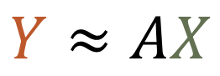

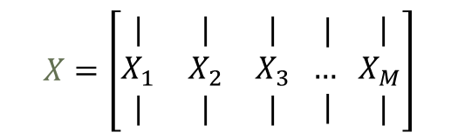
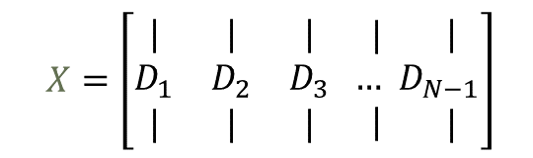
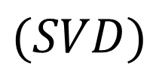

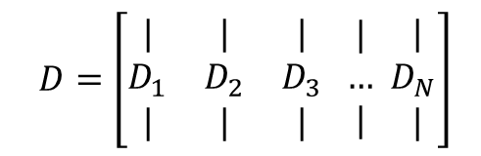

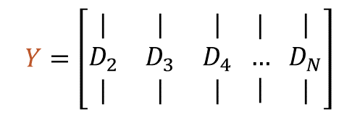
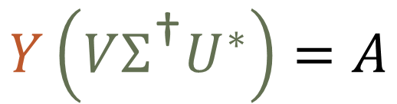

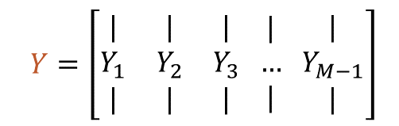
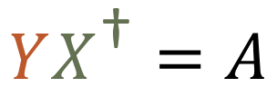
DMD Background Theory
- Used to forecast data from one point to the next.
$$X=\left[\begin{matrix}| & | & | \\ D_{1} & D_{2} & D_{3} \\ | & | & |\end{matrix}\begin{matrix} | \\ … \\ |\end{matrix}\begin{matrix} | \\ D_{N−1} \\ |\end{matrix}\right]$$
$$Y≈AX$$
$$X=\left[\begin{matrix}| & | & | \\ X_{1} & X_{2} & X_{3} \\ | & | & |\end{matrix}\begin{matrix} | \\ … \\ |\end{matrix}\begin{matrix} | \\ { X}_{M} \\ |\end{matrix}\right]$$
$$YX^{\text{†}}=A$$
$$D=\left[\begin{matrix}| & | & | \\ D_{1} & D_{2} & D_{3} \\ | & | & |\end{matrix}\begin{matrix} | \\ … \\ |\end{matrix}\begin{matrix} | \\ { D}_{N} \\ |\end{matrix}\right]$$
$$A$$
$$A$$
$$A$$
$$Y\left(VΣ^{\text{†}}U^{∗}\right)=A$$
$$Y=\left[\begin{matrix}| & | & | \\ D_{2} & D_{3} & D_{4} \\ | & | & |\end{matrix}\begin{matrix} | \\ … \\ |\end{matrix}\begin{matrix} | \\ { D}_{N} \\ |\end{matrix}\right]$$
$$Y=\left[\begin{matrix}| & | & | \\ Y_{1} & Y_{2} & Y_{3} \\ | & | & |\end{matrix}\begin{matrix} | \\ … \\ |\end{matrix}\begin{matrix} | \\ { Y}_{M−1} \\ |\end{matrix}\right]$$
$$X=UΣV^{∗}$$
$$(SVD)$$
Overview
Purpose
Theory
Algorithm
Results
Notes:
For now let’s revisit DMD method briefly
As a reminder, DMD was used primarily to forecast data.
Let’s say we have a matrix of data where in each column we have some spatial information, and as we go from 1 column to the other, we are jumping from 1 time to the next.
Now were going to separate this matrix into 2 such that we can map 1 column to the next.
These matrices are just formed like this…
DMD tells me that I can approximately map 1 datapoint to the next with a matrix.
In general, I can multiply X with a matrix A such that it will bring me forward in time.
So how do we find A?
We can use the pseudoinverse of X which is taking SVD and applying the inverse.
Ill elaborate on SVD in a later slide.

Slide 8
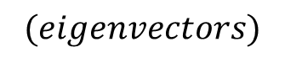
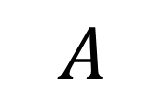
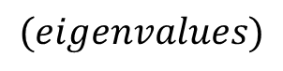
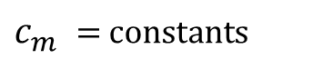
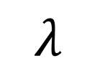

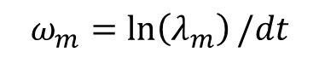
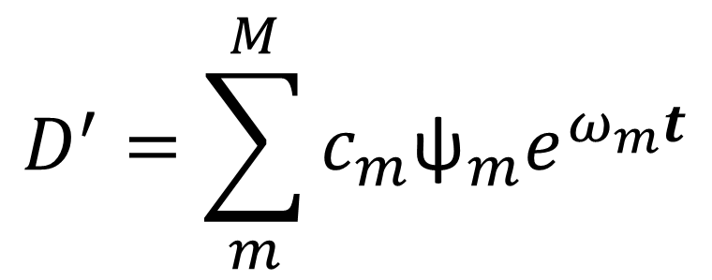
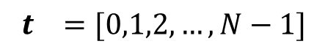
DMD Background Theory
DMD matrix
$$\text{ψ}$$
$$(eigenvectors)$$
$$D^{′}=\sum_{m}^{M}{c_{m}{\text{ψ}}_{m}e^{ω_{m}t}}$$
$$A$$
$$λ$$
$$(eigenvalues)$$
$$c_{m} \text{= }\text{constants}$$
$$ω_{m}=\ln\left(λ_{m}\right)/dt$$
$$t =[0,1,2,…, N−1]$$
Overview
Purpose
Theory
Algorithm
Results
Notes:
A is called DMD matrix
It contains the underlying dynamics of the data points.
We can find the eigenvectors and the corresponding eigenvalues.
We can then use these to reconstruct the data matrix using the eigenbasis expansion.
Cm are constants obtained from initial conditions.
Omega are the frequencies converted form the eigenvalues
t is a vector of time units

Slide 9
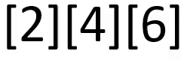
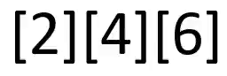

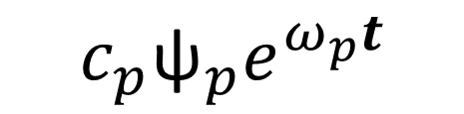
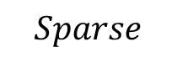
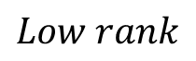

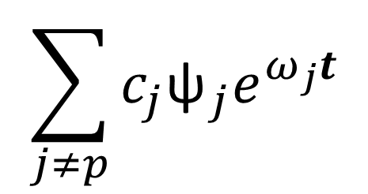
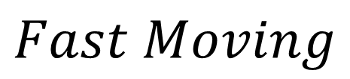
DMD Background Theory
$$Low rank$$
$$Sparse$$
$$\sum_{j≠p}{c_{j}{\text{ψ}}_{j}e^{ω_{j}t}}$$
$$c_{p}{\text{ψ}}_{p}e^{ω_{p}t}$$
$$\left|ω_{p}\right|≈0$$
$$Slow Moving$$
$$Fast Moving$$
Overview
Purpose
Theory
Algorithm
Results
Notes:
The frequency omega allows us to reconstruct the slow or fast moving data values
So If omega is found near zero, so we have small frequencies and thus we are reconstructing values that are slowly drifting
In terms of pixels, it might look like this
If we take all the other frequencies, then we are finding the data that changes a lot
So the pixels might look like this passing through time
But in my case, Im dealing with static images, so how does DMD help when there is no time component?
(water)

Slide 10
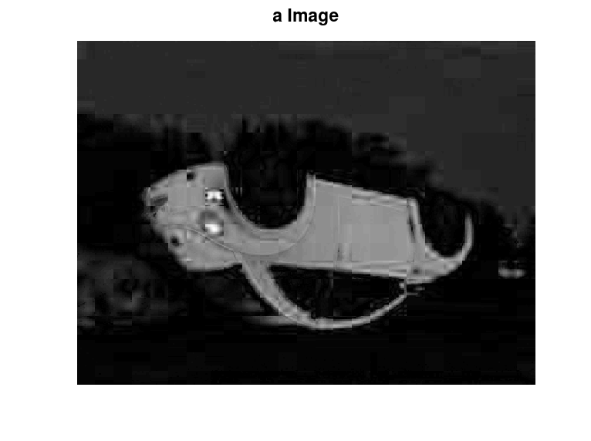
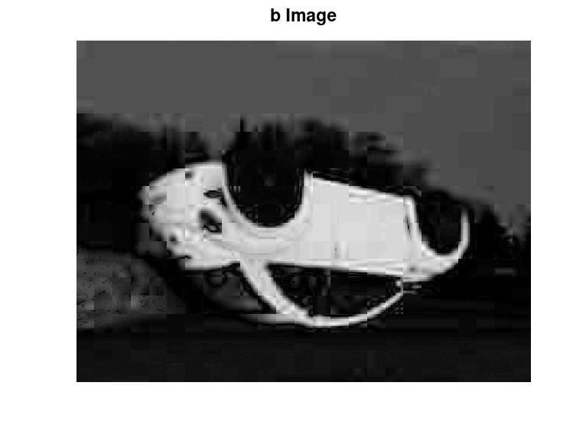
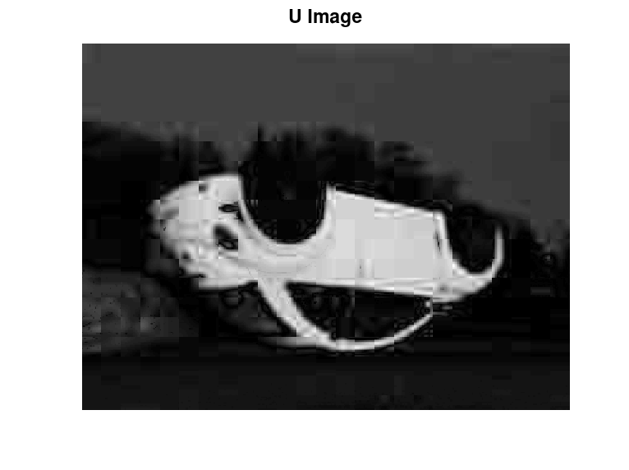
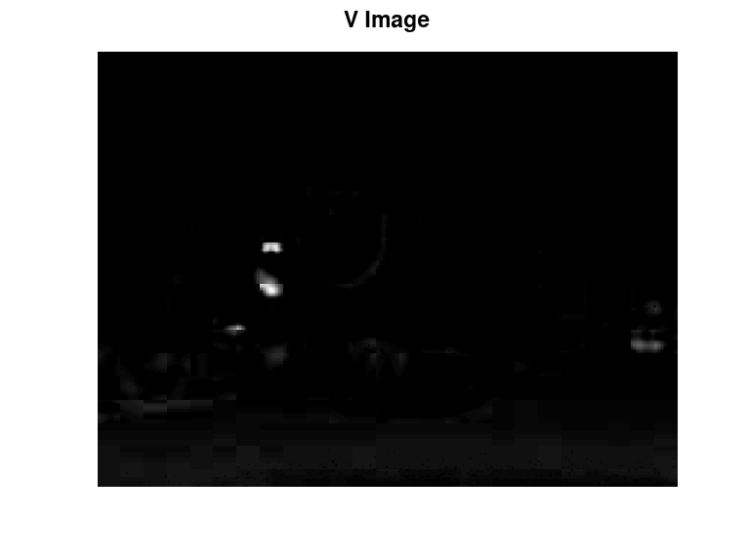
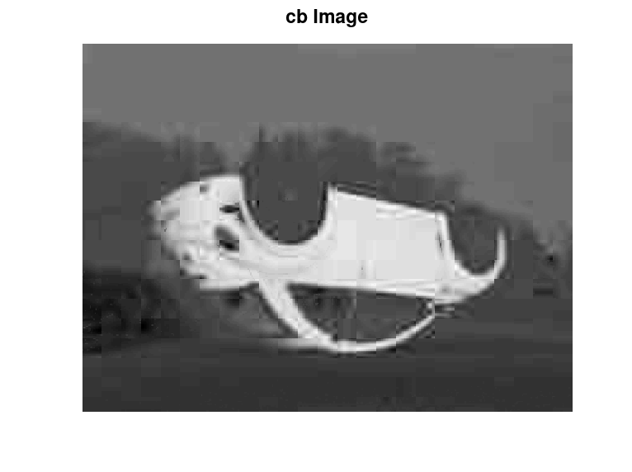
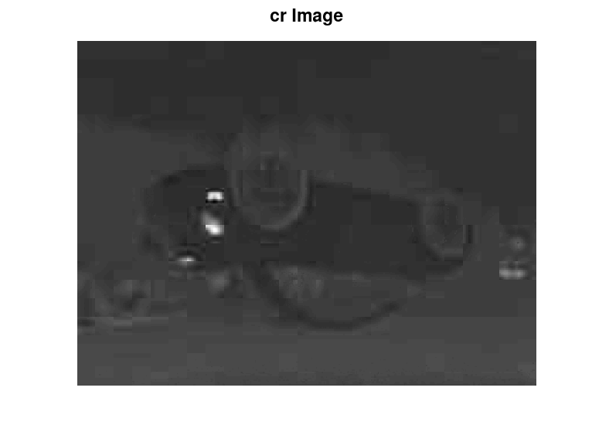
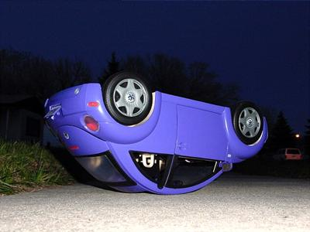
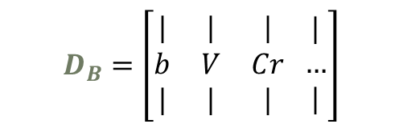
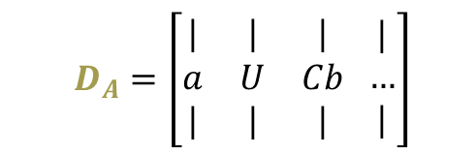
Algorithm and Implementation
Lab
1.0 Color Spaces
YUV
RGB
YCbCr
$$D_{A}=\left[\begin{matrix}| & | & | \\ a & U & Cb \\ | & | & |\end{matrix}\begin{matrix} | \\ … \\ |\end{matrix}\right]$$
$$D_{B}=\left[\begin{matrix}| & | & | \\ b & V & Cr \\ | & | & |\end{matrix}\begin{matrix} | \\ … \\ |\end{matrix}\right]$$
Overview
Purpose
Theory
Algorithm
Results
Notes:
So let’s talk about the algorithm,
I am going to cover the general steps to give you guys an idea.
To use DMD, we need to artificially create the frames.
We do this by using the different color spaces.
Usually, images stored as RGB where these 3 values form the color.
But exist other spaces where color is stored differently.
Here we see 3 different color spaces where all the color information are stored in the last 2 letters and the first letter stores the luminosity or brightness values. (well use this a bit later)
It turns out that these color spaces can give different parts that are salient
We can use these images, repeat them, shuffle the sequences and add the values to create our data matrices.
Here we make two in case the other happens to collect the images that don’t have the salient regions

Slide 11
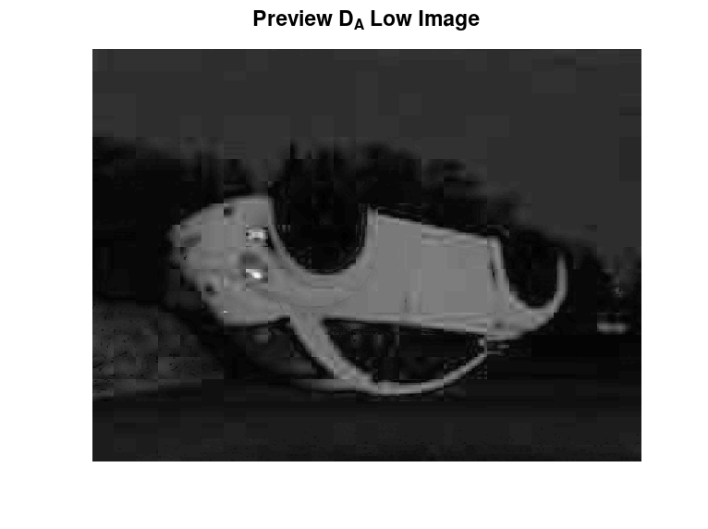
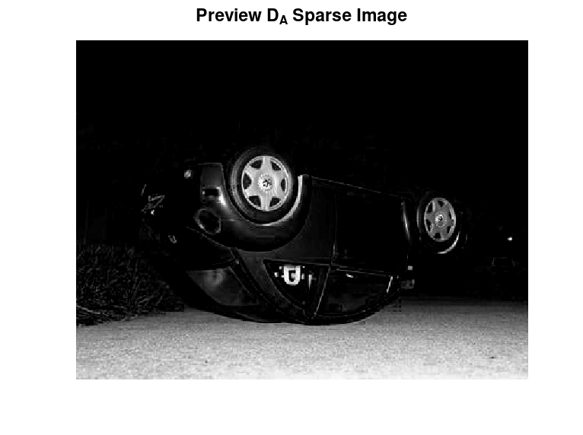
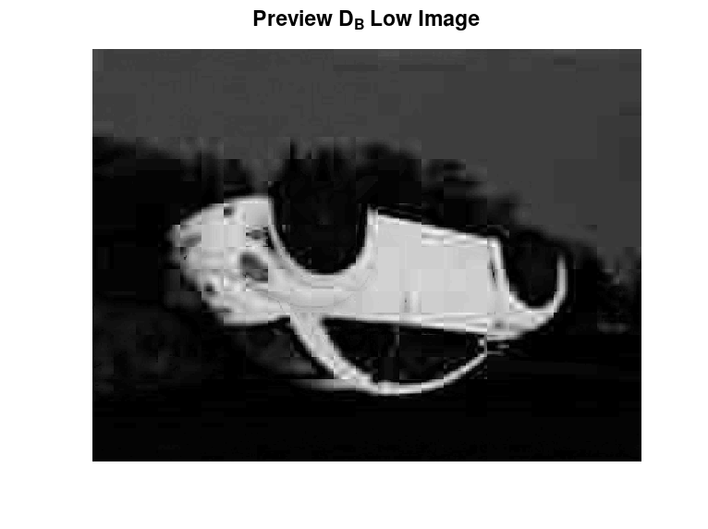
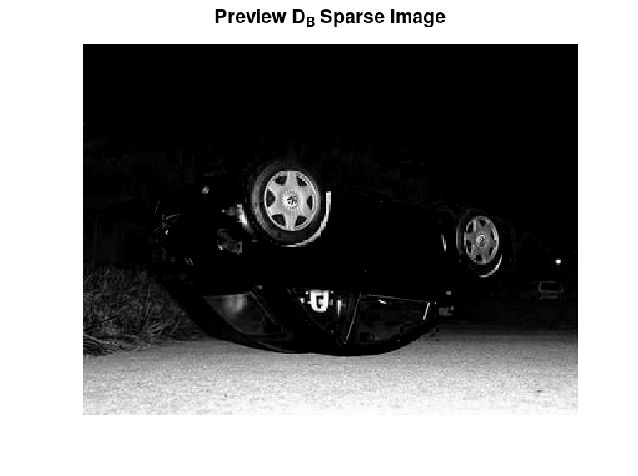
Algorithm and Implementation
1.1 DMD Application
Overview
Purpose
Theory
Algorithm
Results
Notes:
Now here is the dmd process where we separate the low and sparse components.
Here, in this step its a little bit diff from the published paper,
In their paper, they note the sparse components contain the salient regions, while in my case I seem to be getting the low component as salient.
So I continued with this idea.
Here I’m just subtracting the low rank image from the grey image to obtain the sparse components.

Slide 12
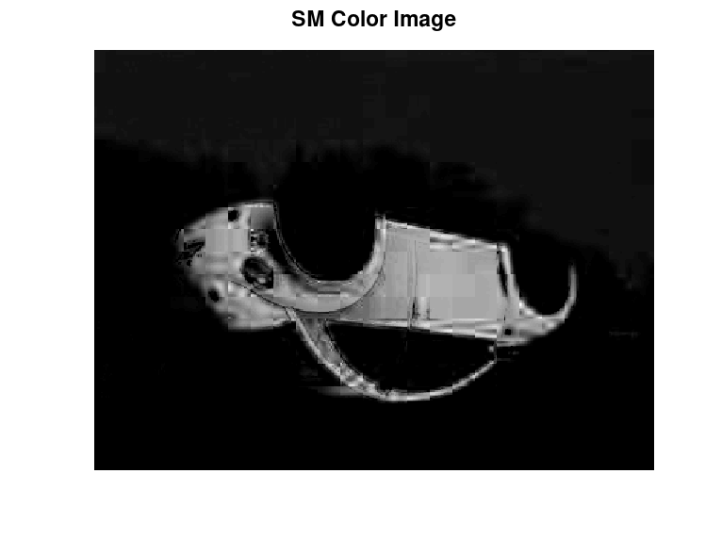

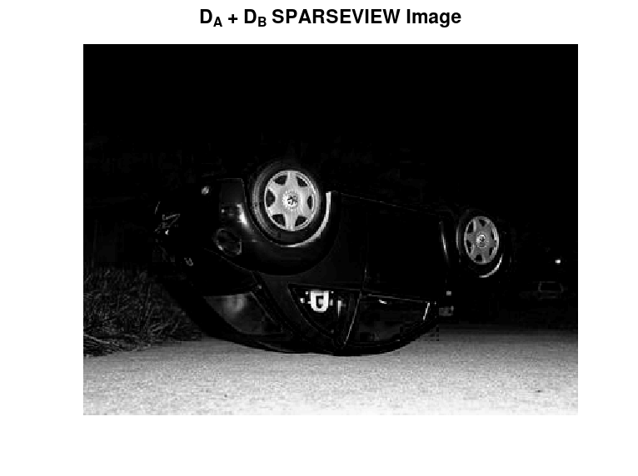
Algorithm and Implementation
1.2 Color Saliency Map
-
=
Overview
Purpose
Theory
Algorithm
Results
Notes:
If I sum up the low and sparse components
Then subtract the sparse image (the background) from the low rank image, I can obtain only the salient region
It looks nicer than it should because I made the bright spots brighter and the dark regions darker.
This already looks pretty good, but it can be slightly better because This is only using color information but what about the brightness?

Slide 13
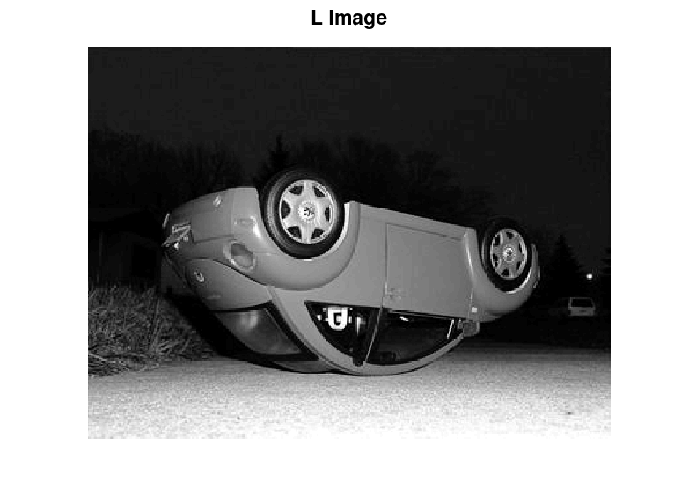


Algorithm and Implementation
2.0 Luminosity Spaces
Lab
$$\left[\begin{matrix}σ_{1} & ⋯ & 0 \\ ⋮ & ⋱ & ⋮ \\ 0 & ⋯ & σ_{r}\end{matrix}\right]$$
SVD
=
U
$Σ$
V*
YUV
YCbCr
Overview
Purpose
Theory
Algorithm
Results
Notes:
Remember that we haven’t used the luminosity images yet
One thing we can do is to perform SVD on these images.
SVD will allow us to find the important components in an image. We can find this by looking at the singular values in this sigma matrix.
The first singular value represents the information that is more important. In images, this turns out to be the background information.
So if we only take intermediate singular values and reconstruct the images, we get what’s important to us (salient regions)

Slide 14







Algorithm and Implementation
2) Luminance Information
$$σ_{3−5}$$
$$σ_{3−7}$$
$$σ_{3−10}$$
$$D_{L}=\left[\begin{matrix}| & | & | \\ σ_{3−5} & σ_{3−6} & σ_{3−7} \\ | & | & |\end{matrix}\begin{matrix} | \\ … \\ |\end{matrix} \begin{matrix} | \\ σ_{3−s} \\ |\end{matrix}\right]$$
Overview
Purpose
Theory
Algorithm
Results
Notes:
Notice the increasing number of intermediate singular values used during the reconstructions.
Pause
Okay so let’s group these images into a single data matrix and perform DMD

Slide 15


Algorithm and Implementation
2.1 DMD Application
Overview
Purpose
Theory
Algorithm
Results
Notes:
This time we obtain the salient regions through the sparse components which we use for the saliency map.
If we take this as well as the color saliency map obtained before.

Slide 16




Post-Processing and Final Saliency Map
- Gaussian distribution
- Morphological Transformations
Erosion and Dilation
- Sigmoid Function on each pixel intensity
+
=
Overview
Purpose
Theory
Algorithm
Results
Notes:
We can do some post processing on them.
Giving more weight to the center using gaussian distribution,
Doing morphological transformations with erosion and dilations basically removing noise
Enhancing the pixel brightness using a sigmoid function
Then add the two images together to obtain a final saliency map.
Okay it looks good, its still not great. This is the true salient region called the ground truth
(pause)
Okay so how did I do compared to the original article?

Slide 17



Results
O.K. Sikha et al, 2017
My Version
Overview
Purpose
Theory
Algorithm
Results
Notes:
That’s pretty close. Theirs is slightly better. In some cases I have artifacts, in others I have less

Slide 18
















MSRA-B dataset
Original
Ground Truth
DMD
GMR
Yang et al, 2013
Overview
Purpose
Theory
Algorithm
Results
Notes:
Let’s look at some other results that I have.
These are from the MSRA-B dataset, a commonly used benchmarking dataset.
These images are known to have obvious salient regions.
On the top row we have the original images.
…
Just for fun, I was able to find the code of the algorithm from Yang et al which uses something called superpixels. Theirs look really nice, but you can see that that they have also struggles with this potion

Slide 19








Failed Results
Original
Ground Truth
DMD
GMR
Overview
Purpose
Theory
Algorithm
Results
Notes:
Its good to look at good results, but its also good to look at where it can fail hard.
It fails when there are other colors and similar colors in the background and foreground and when theres a lot of things going on in the background
And just for fun here is GMR again. They also had difficulties, much less but still.

Slide 20
Summary and Conclusion
Salient Regions are regions where human vision are attracted to at first glance
Many models and algorithms exists
DMD provides a suitable way to obtain salient regions
- Successful Salient region detection
- Fails if many things or similar colors are in the background
Can provide a computationally inexpensive way of detecting Salient regions

